Slide 1
Consumindo API sem acoplamento
Gabriel Baltazar
gabrielbaltazar.dev@gmail.com

Slide 2
Agenda
Introdução
Desacoplando de componentes
Preparando o ambiente
Exemplos
Consumindo api com objetos Delphi
Consumindo api com dataSet

Slide 3
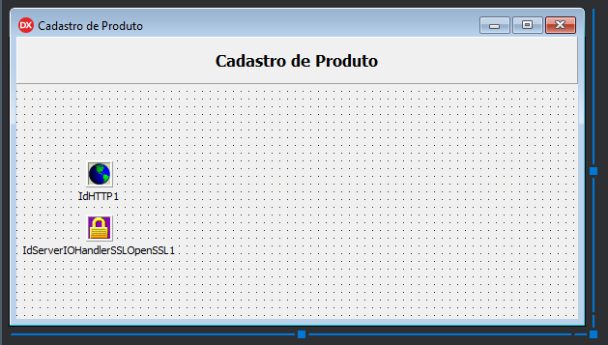
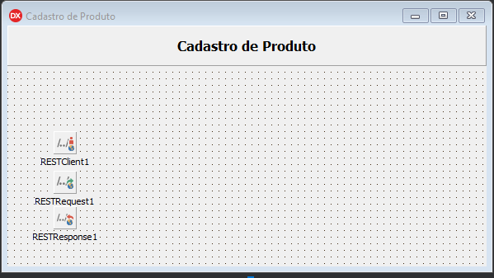
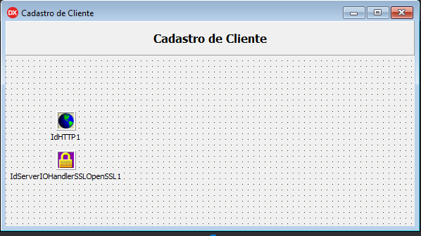
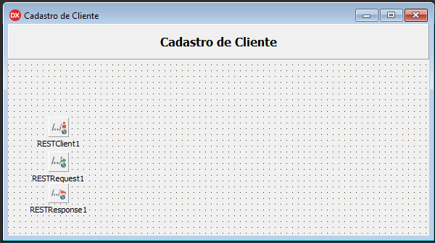
Introdução

Slide 4
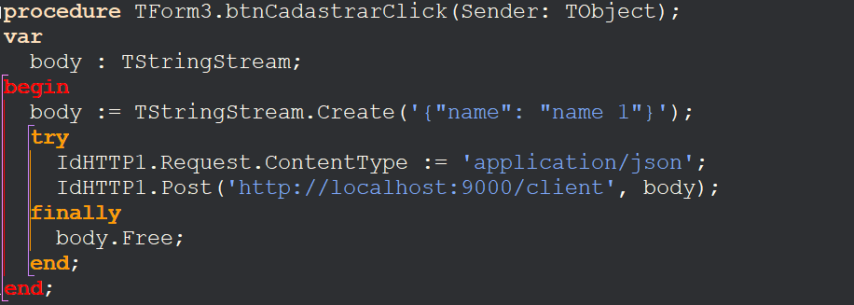
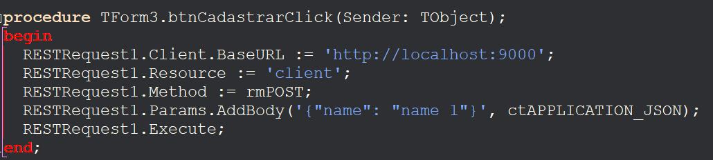
Introdução

Slide 5
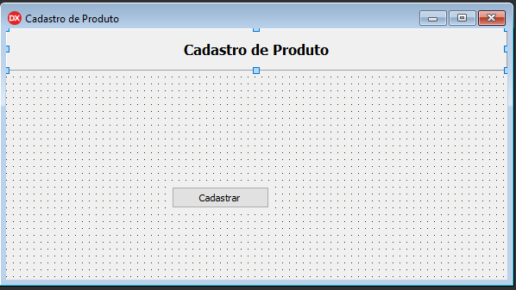
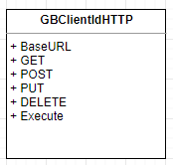
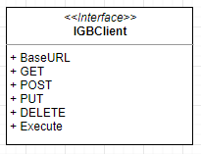
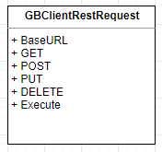
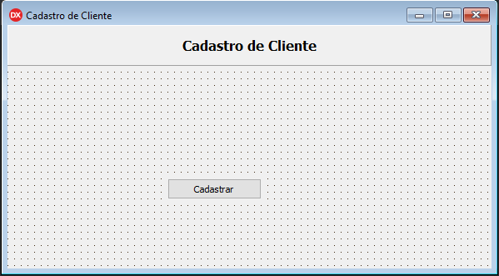
Desacomplando

Slide 6
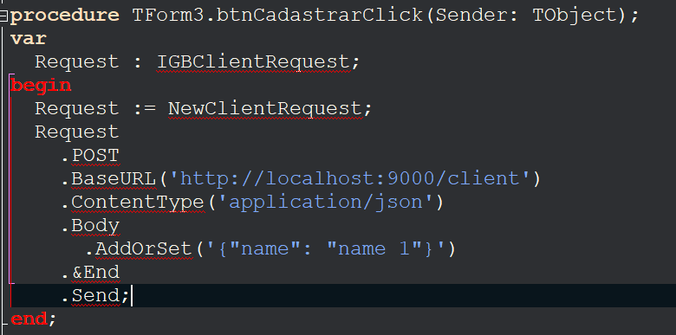
Desacoplando

Slide 7
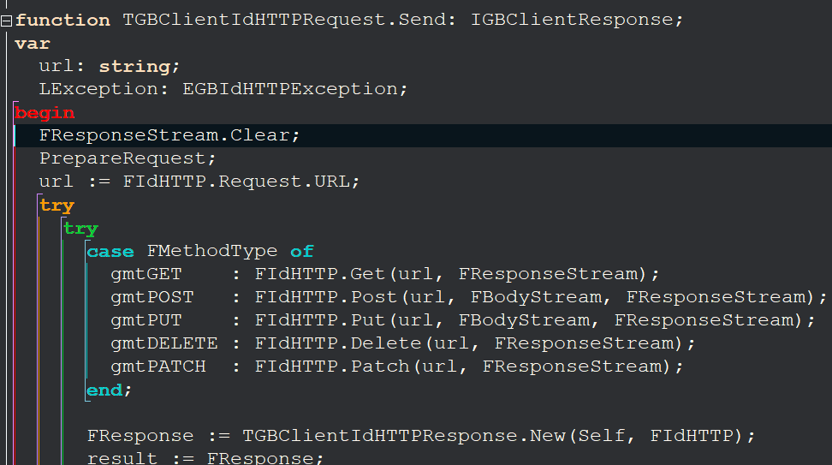
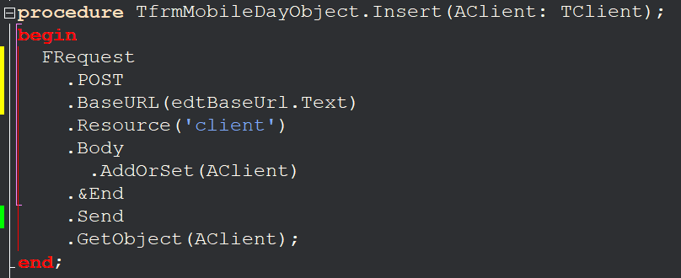
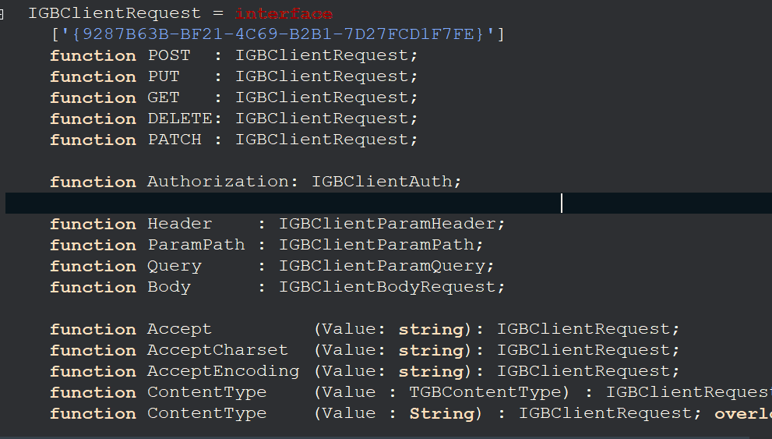
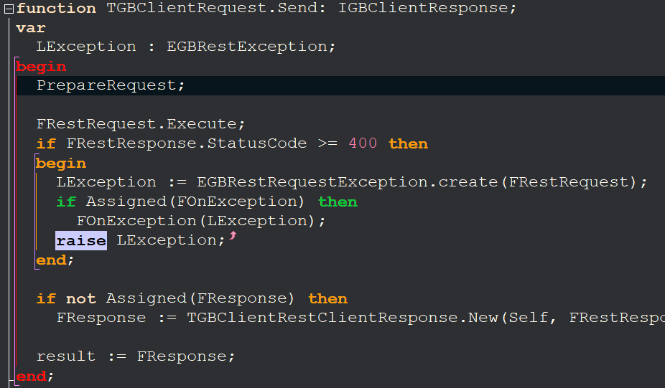
Desacomplando

Slide 8
Preparando o Ambiente
Server
Boss - https://github.com/HashLoad/boss/releases/download/v3.0.4/boss.exe
Horse - https://github.com/HashLoad/horse
Horse-Basic-Auth - https://github.com/HashLoad/horse-basic-auth
Client
Boss - https://github.com/HashLoad/boss/releases/download/v3.0.4/boss.exe
GBClient - https://github.com/gabrielbaltazar/GBClient.git

Slide 9

Let’s Code

Slide 10




Obrigado!!!
gabrielbaltazar.dev@gmail.com
github.com/gabrielbaltazar
linkedin.com/in/gabrielbaltazar-dev/
Gabriel Baltazar
Fontes e Apresentação
https://github.com/gabrielbaltazar/mobileday2020

